Slide 1

Python Course Chapter 13
Miscellaneous
Information II

Slide 2
type(), isinstance() and issubclass()
Python provides some type checking functions, including:
type(object) – returns class type of the argument passed as parameter.
isinstance(object, class) – returns a Boolean value indicating if the object belongs to or inherits from the class.
isusbclass(classA, classB) - returns a Boolean value indicating if 2 classA is a subclass of classB. Notice that a class is a subclass of itself. This concept is from set theory – any set is its own subset.

Slide 3
Duck Typing
Even though we have the type(), isinstance() and issubclass() functions to check an object’s type and inheritance relations, we don’t usually use them in Python (unless for debugging purposes.)
Python also has a feature that makes using objects even easier; that is – Duck Typing. This name originates from American writer and poet James Whitcomb Riley, who came up with the idea of the Duck Test. The Duck test is a form of abductive reasoning, and it says that:
If it looks like a duck, swims like a duck, and quacks like a duck, then it probably is a duck.

Slide 4
Duck Typing
Duck typing refers to Python’s way of determining whether an object is a required type for an operation, focusing on its interface rather than its type.
If an operation needs an iterator, for example, the object used doesn’t need to be a subclass of any particular iterator or any iterator at all. All that matters is that the object used as an iterator is able to yield a series of objects in an expected way. By contrast, stricter rules of inheritance are enforced in a language like Java.
Basically, we don’t necessarily need to know the data type of an object, as long as the object has the functionality we need.

Slide 5
TypedList
In many other programming languages, all elements inside one list must be the same type. The advantage of a one-type list includes tracking errors and making the list stable. If we add something that shouldn’t be in the list, we can quickly figure it out at the beginning of our development.
In languages like Java or C++, we can only create lists of a specific type at a time. However, we don’t have that built-in in Python; therefore, we have to build it on our own. Now, let’s learn how to create this data type TypedList.

Slide 6
Decimal, Binary, and Hexadecimal
Human beings use decimal number systems; however, computers use binary number systems (due to the nature of electricity.) On top of that, computer hardware (including CPUs and memories) uses a hexadecimal number system.
When working with files in Python, we might come across raw data (such as images or music); then, Python byte comes in handy. Before heading to the concept of byte, let’s spend time learning the different number systems.

Slide 7
Decimal, Binary, and Hexadecimal
In decimal number system, the number set is:
{0, 1, 2, 3, 4, 5, 6, 7, 8, 9}
Then, we count from 0, 1, 2, …, to 9. Since we don’t have any digit to use anymore, we use 2 digits to mark the next number. Then, we put 1 at the front and 0 at the end; that makes 10. We continue to count from 10, 11, 12, …, to 19. We don’t have any digit to use anymore at the last digit, so we do 20.
In binary number system, the number set is:
{0, 1}

Slide 8
Decimal, Binary, and Hexadecimal
Binary | Decimal
0 | 0
1 | 1
10 | 2
11 | 3
100 | 4
101 | 5
110 | 6
111 | 7
1000 | 8
1001 | 9
1010 | 10
1011 | 11
Then, we count from 0 to 1, and we don’t have any digits to use anymore. We then use 2 digits, which makes 10. Then, we count from 10, 11, and we don’t have any digit to use anymore at the last digit, so we do 100. Then, we count from 100, 101, 110, 111, and we don’t have any digit to use anymore at the last digit, so we do 1000. Then, we count from 1000, 1001, 1010, 1011, 1100, 1101, 1110, 1111, then we continue…
A mapping from binary to decimal can be shown in a table:

Slide 9
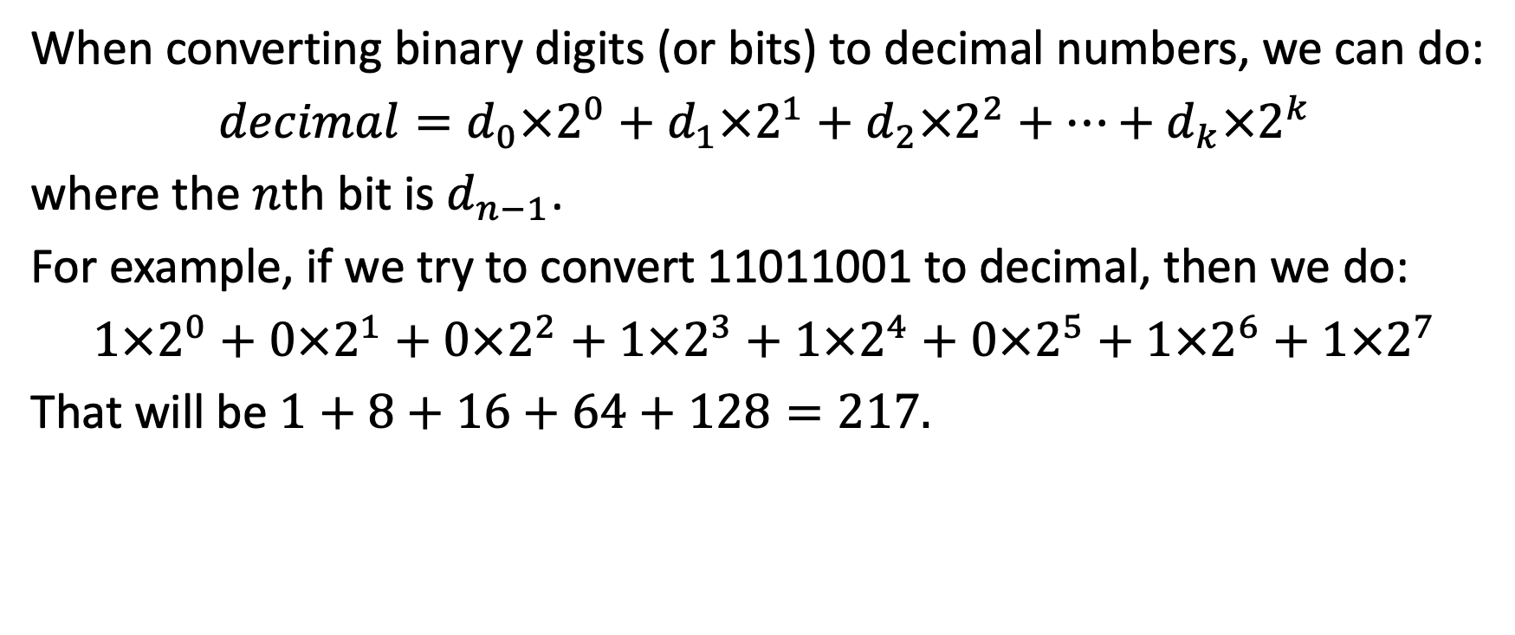
Decimal, Binary, and Hexadecimal
When converting binary digits (or bits) to decimal numbers, we can do:
$decimal=d_{0}×2^{0}+d_{1}×2^{1}+d_{2}×2^{2}+…+d_{k}×2^{k}$
where the $n$th bit is $d_{n−1}$.
For example, if we try to convert 11011001 to decimal, then we do:
$1×2^{0}+0×2^{1}+0×2^{2}+1×2^{3}+1×2^{4}+0×2^{5}+1×2^{6}+1×2^{7}$
That will be $1+8+16+64+128=217.$

Slide 10
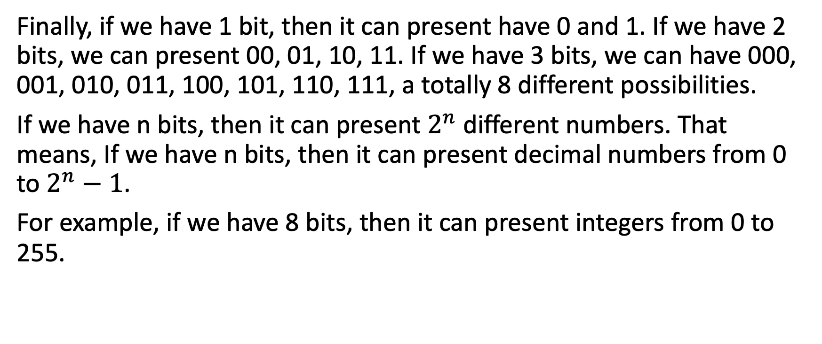
Decimal, Binary, and Hexadecimal
Finally, if we have 1 bit, then it can present have 0 and 1. If we have 2 bits, we can present 00, 01, 10, 11. If we have 3 bits, we can have 000, 001, 010, 011, 100, 101, 110, 111, a totally 8 different possibilities.
If we have n bits, then it can present $2^{n}$ different numbers. That means, If we have n bits, then it can present decimal numbers from 0 to $2^{n}−1$.
For example, if we have 8 bits, then it can present integers from 0 to 255.

Slide 11
Decimal, Binary, and Hexadecimal
The Hexadecimal number system works the same way. The number set is:
{0, 1, 2, 3, 4, 5, 6, 7, 8, 9, A, B, C, D, E, F}
We count from 0, 1, 2, …, to F. Then, we don’t have any digits to use anymore, so we do 10. Then, we count from 10, 11, 12, …, 1A, 1B, …, 1F. Then, we don’t have any digit to use anymore at the last digit, so we do 20. Then, we count from 20, 21, 22, …, to 2F.
A mapping from decimal to hexadecimal can be shown in a table:
Decimal | Hexadecimal
0 | 0
… | …
10 | A
11 | B
12 | C
13 | D
14 | E
15 | F
16 | 10
17 | 11
18 | 12
19 | 13

Slide 12
Decimal, Binary, and Hexadecimal
Converting numbers from binary to hexadecimal (or vice versa) is very simple. Every 4 bits can be converted into one hexadecimal digit, and every hexadecimal digit can be converted into 4 bits.
For example, we can convert 11001010 to binary by:
1100 is 12 in decimal, and 12 is C in hexadecimal.
1010 is 10 in decimal, and 10 is A in hexadecimal.
Therefore, 11001010 is CA in hexadecimal.

Slide 13
Decimal, Binary, and Hexadecimal
For example, we can convert E4 in hexadecimal to binary by:
E in hexadecimal is 14 in decimal, and 14 is 1110 in binary.
4 in hexadecimal is 4 in decimal, and 4 is 0100 in binary.
Therefore, E4 is 11100100 in binary.

Slide 14
Decimal, Binary, and Hexadecimal
In Python, when we print out an object that doesn’t implement the __str__() method (for example, Python built-in map object), then we get something like
<map object at 0x7f7f180cc7f0>
The 0x at means the following numbers are hexadecimal, and that number represents the memory address in our RAM where the object is located. Notice that all numbers and letters after 0x are all in the set of hexadecimal number system:
{0, 1, 2, 3, 4, 5, 6, 7, 8, 9, A, B, C, D, E, F}

Slide 15
Number System in Python
Python has tools for nearly every computer-related task, and converting hexadecimal values into binary values is no exception.
hex(number) - converts the specified integer number into a hexadecimal value. The return string always starts with the prefix 0x.
bin(number) - returns the binary version of a specified integer number. The result will always start with the prefix 0b.

Slide 16
Introduction to Encoding
Before we learn a special data type byte in Python, we need to first learn the concept of encoding.
Since computers can only understand 0 and 1, in order to show characters in computers, we need a way to map 0s and 1s into characters. ASCII (American Standard Code for Information Interchange) is a character encoding standard for electronic communication.
ASCII codes represent text in computers, telecommunications equipment, and other devices. Most modern character-encoding schemes are based on ASCII, although they support many additional characters.

Slide 17
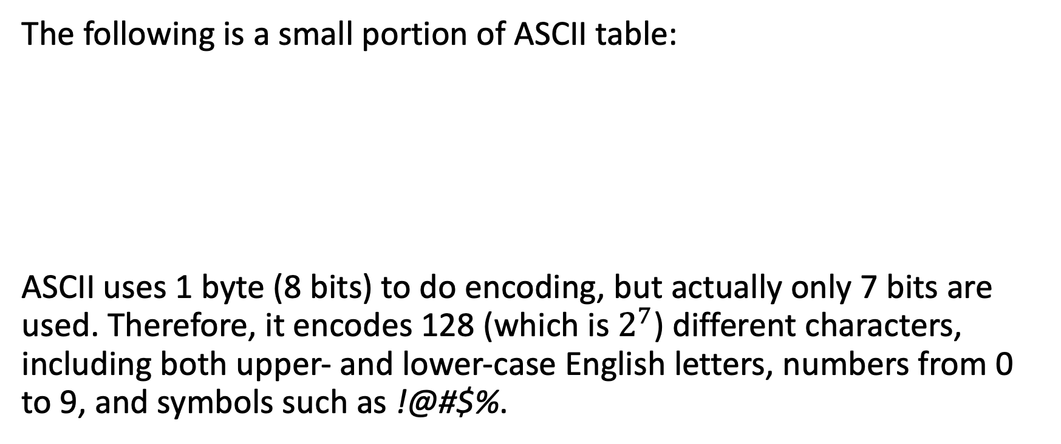
Introduction to Encoding
The following is a small portion of ASCII table:
ASCII uses 1 byte (8 bits) to do encoding, but actually only 7 bits are used. Therefore, it encodes 128 (which is $2^{7}$) different characters, including both upper- and lower-case English letters, numbers from 0 to 9, and symbols such as !@#$%.
Binary | Decimal | Hexadecimal | Character
0010 0001 | 33 | 21 | !
0100 0001 | 65 | 41 | A
0100 0010 | 66 | 42 | B

Slide 18
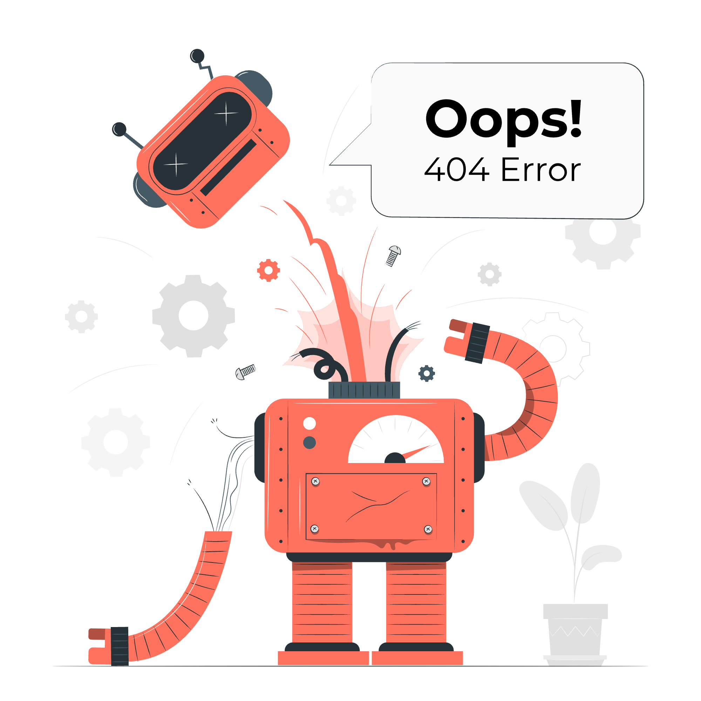
Introduction to Encoding
However, it doesn’t include characters from other languages, such as Chinese or Korean letters.
Therefore, we need something more capable, something that can deal with more letters.

Slide 19
Unicode and Python Bytes
Unicode is a set of characters (a superset of ASCII.) The standard, which the Unicode Consortium maintains, defines 144,697 characters covering 159 modern and historic scripts, as well as symbols, emoji, and non-visual control and formatting codes.
Binary digits mapping to Unicode can be implemented in different ways. The most commonly used encoding is UTF-8. UTF-8 is a variable-length encoding with a minimum of 8 bits per character. Characters with higher code points will take up to 32 bits. So UTF-8 can encode Unicode characters in a range of 1 to 4 bytes.

Slide 20
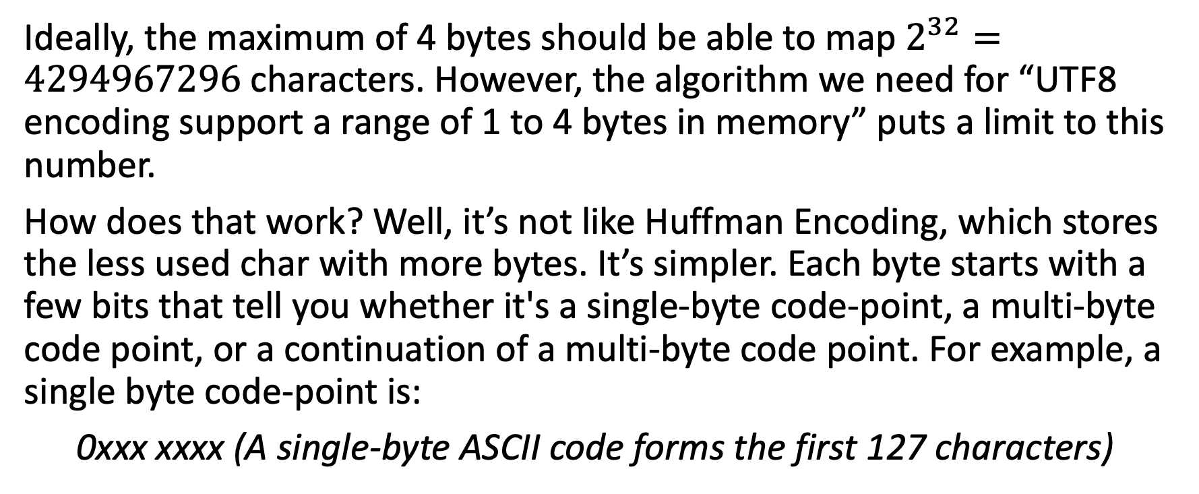
Unicode and Python Bytes
Ideally, the maximum of 4 bytes should be able to map $2^{32}=4294967296$characters. However, the algorithm we need for “UTF8 encoding support a range of 1 to 4 bytes in memory” puts a limit to this number.
How does that work? Well, it’s not like Huffman Encoding, which stores the less used char with more bytes. It’s simpler. Each byte starts with a few bits that tell you whether it's a single-byte code-point, a multi-byte code point, or a continuation of a multi-byte code point. For example, a single byte code-point is:
0xxx xxxx (A single-byte ASCII code forms the first 127 characters)

Slide 21
Unicode and Python Bytes
The multi-byte code-points each start with a few bits that essentially say, "hey, you need to also read the next byte (or two, or three) to figure out what I am." They are:
110x xxxx One more byte follows
1110 xxxx Two more bytes follow
1111 0xxx Three more bytes follow
Finally, the bytes that follow those start codes all look like this:
10xx xxxx (A continuation of one of the multi-byte characters)

Slide 22
Unicode and Python Bytes
In Python 3, a string is an immutable sequence of Unicode characters. This is the true meaning behind each string. (That means we can put emojis in Python strings!!!)
Python supports changing Unicode characters to its bytes, and bytes to Unicode characters. The encoding could be utf-8 or utf-16, or something else.
string.encode(encoding) – returns the bytes that the string maps to based on the encoding.
byte.decode(encoding) – returns the string that the byte maps to based on the encoding.

